Slide 1
Event Handling, Updating State, Binding, and Forms
Alind Kumar Jain - 326835
Shilpa Mandara – 716650
Jason Monroe - 688776

Slide 2
App Feature / Scenario
We want to create a page in our app that has a form where developers can post their bio.

Slide 3
Course Objective:
At the end this 120 min session, you will be able to
Handle DOM events with React components
Update the state of a component
Describe the rules of ‘this’ as applied to binding
Create a form and handle its change

Slide 4
Benefits
Must-know for React development
State changes often in applications
State changes are often a result of events that a user raises in the DOM

Slide 5
Key Topics
Event Handling
Update State with setState()
Binding and ‘this’
Forms

Slide 6
Event Handling

Slide 7
Handling Events in React
Use regular DOM event names in camelCase as a prop name
Set to regular function Or use fat arrow syntax

Slide 8
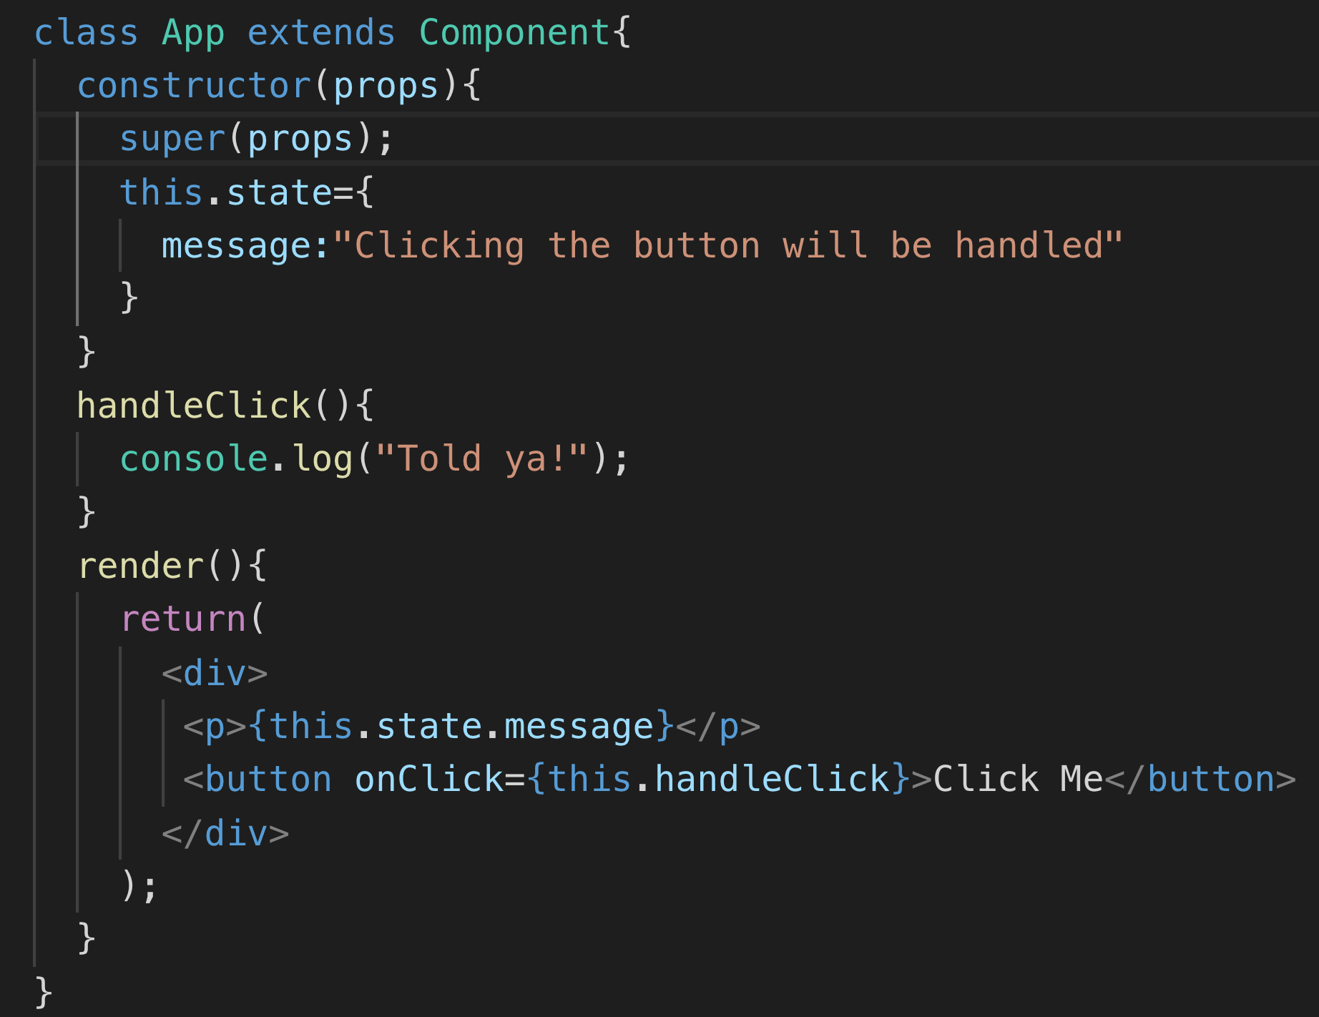
camelCase onClick
Since JSX, use { }

Slide 9
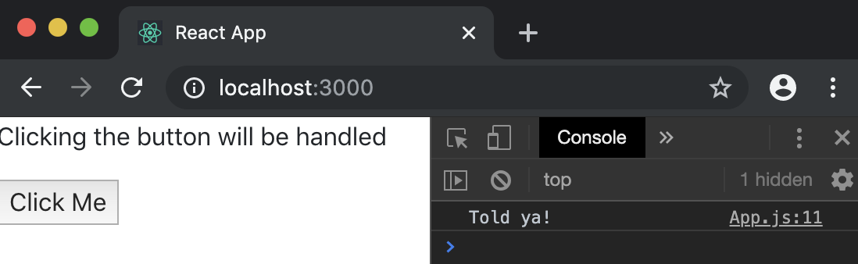
Launched

Slide 10
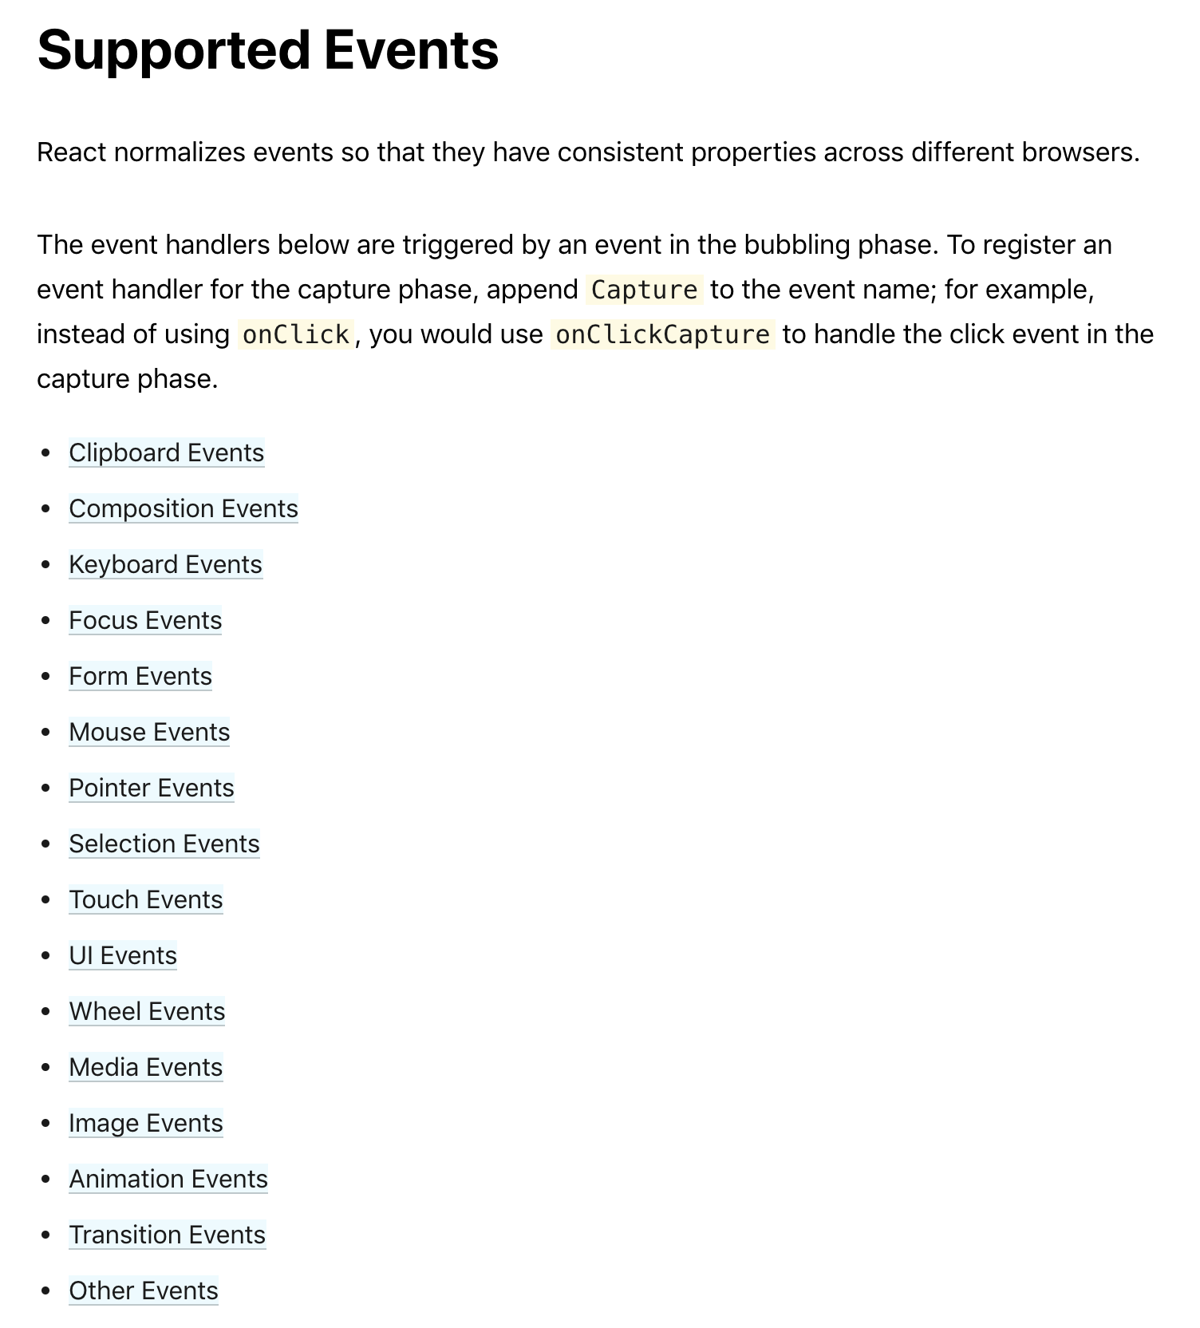
https://reactjs.org/docs/events.html

Slide 11
Update State with setState()

Slide 12
Update State with setState()
Never mutate state directly
this.state.message = “My new message"
Instead, call setState and set the state property to a new object
this.setState({message: “My new message”})

Slide 13
Why?
setState triggers render()
Changing just a property and not the whole object requires React to LOOK at every property.
Changing the whole object is a shallow comparison and bypasses this issue.
Preserve object history by making a copy

Slide 14
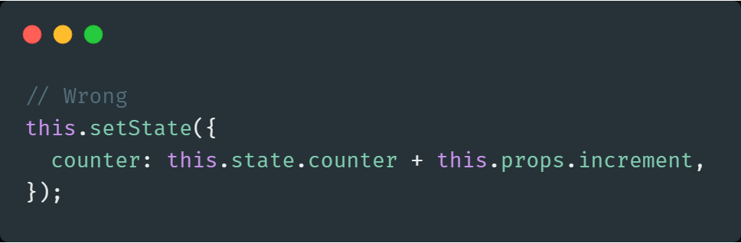
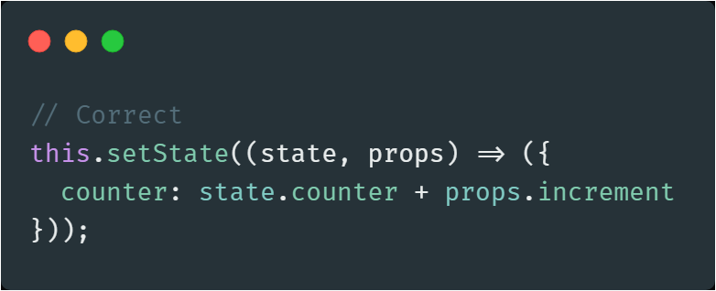
State Updates May Be Asynchronous
React may batch multiple setState() calls into a single update for performance.
Since this.props and this.state may be updated asynchronously, you should not rely on their values for calculating the next state.

Slide 15
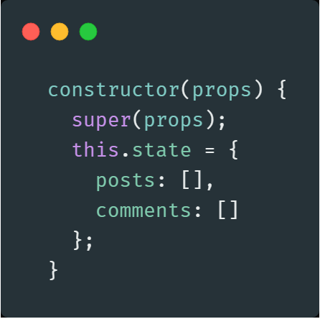
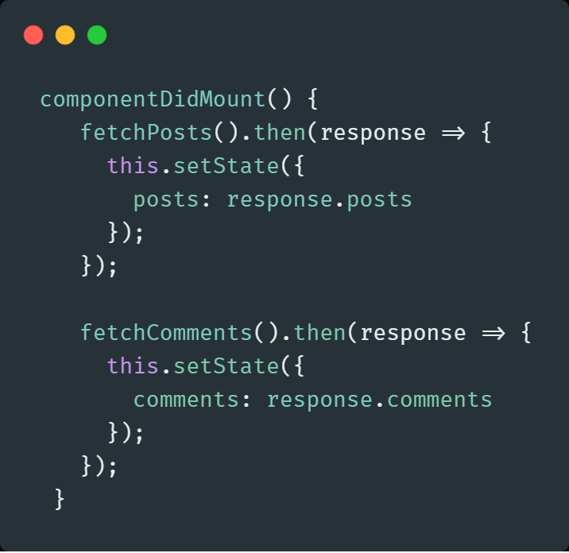
State Updates are Merged - When you call setState(), React merges the object you provide into the current state.

Slide 16
Binding and ‘this’

Slide 17
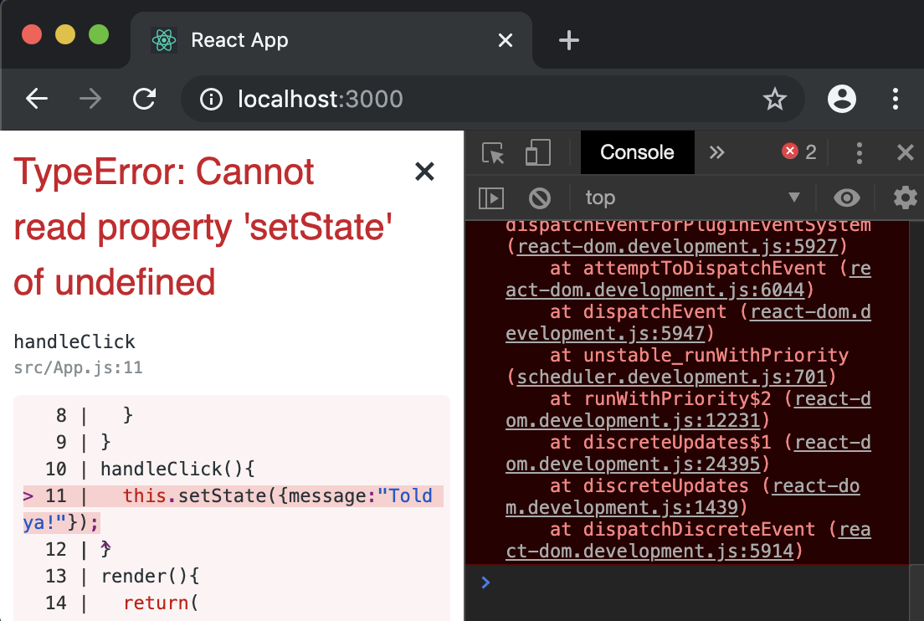
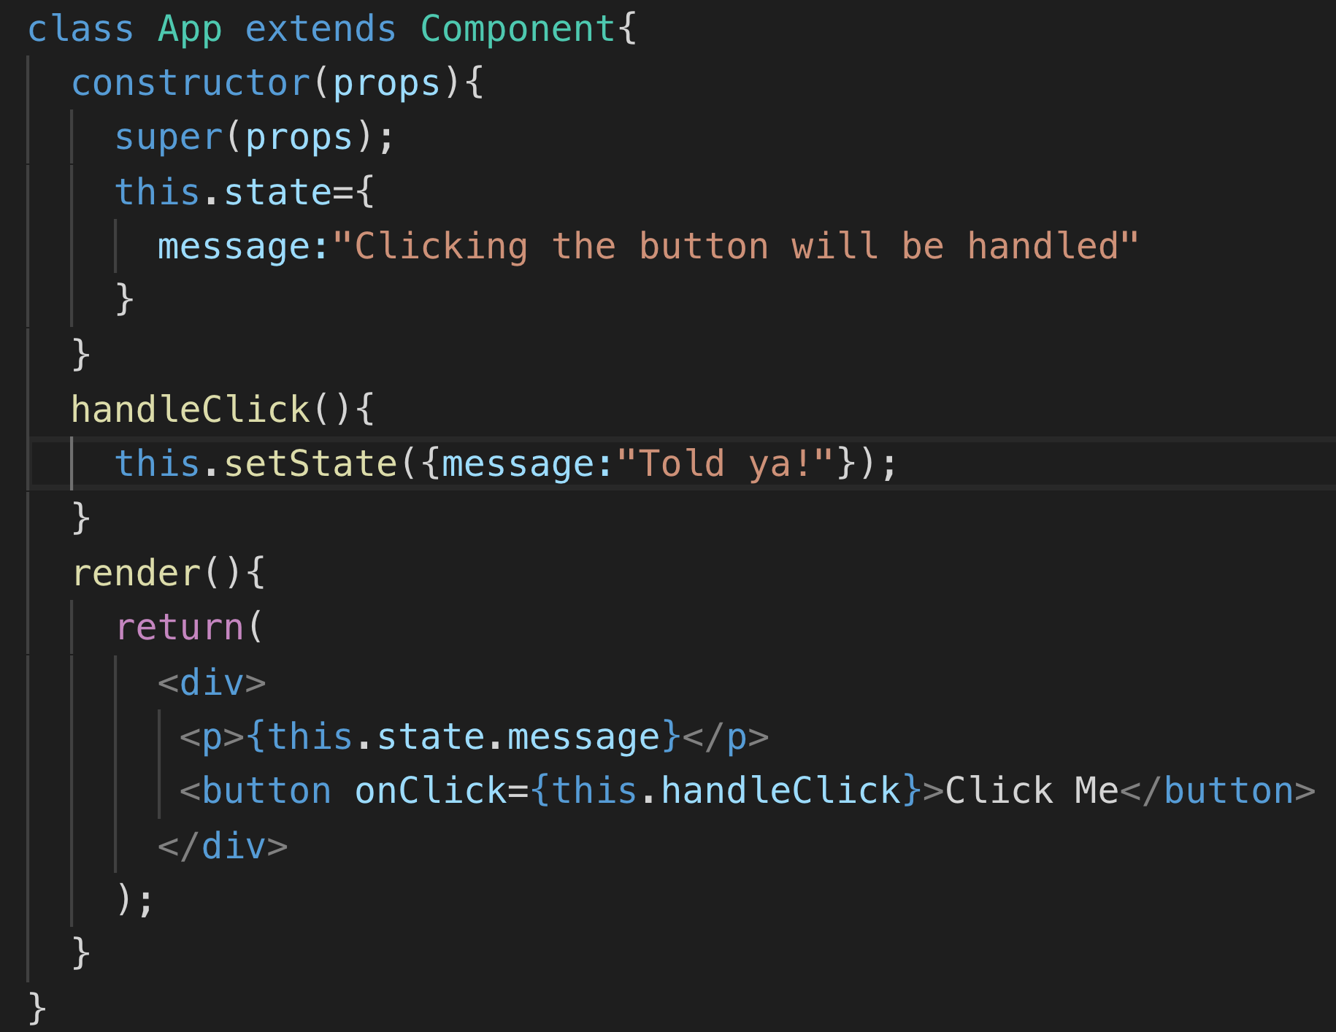
Why doesn’t the below code work?

Slide 18
Binding ‘this’
The function has a different concept of ‘this’ because it is no longer in the context of the class when attached as an event handler in the React component
Binds function to object
https://codeburst.io/the-simple-rules-to-this-in-javascript-35d97f31bde3

Slide 19
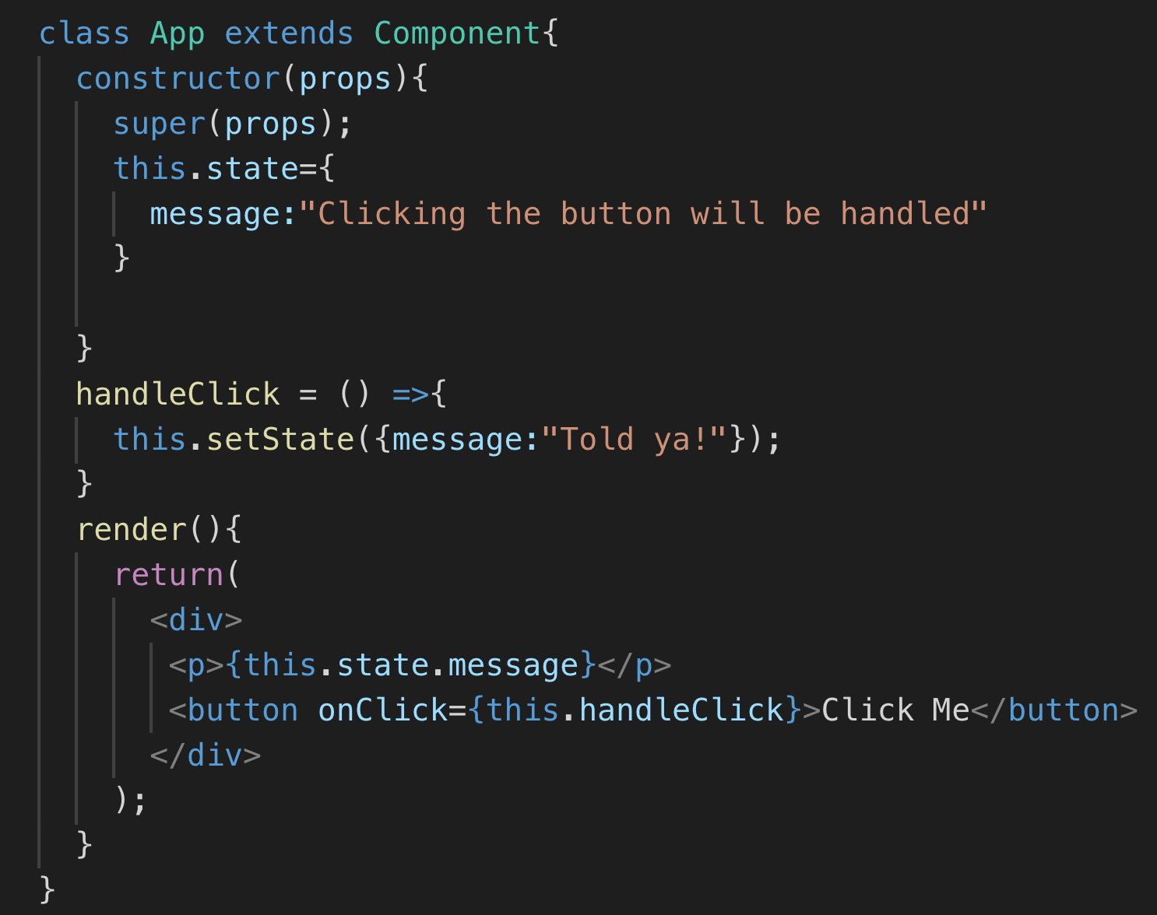
Alternate Syntax

Slide 20
Forms

Slide 21
Controlled vs Uncontrolled
Controlled Form elements are controlled by React and the default HTML actions are ignored, overridden, or prevented
Uncontrolled Form elements behave as they normally would without React intervention

Slide 22
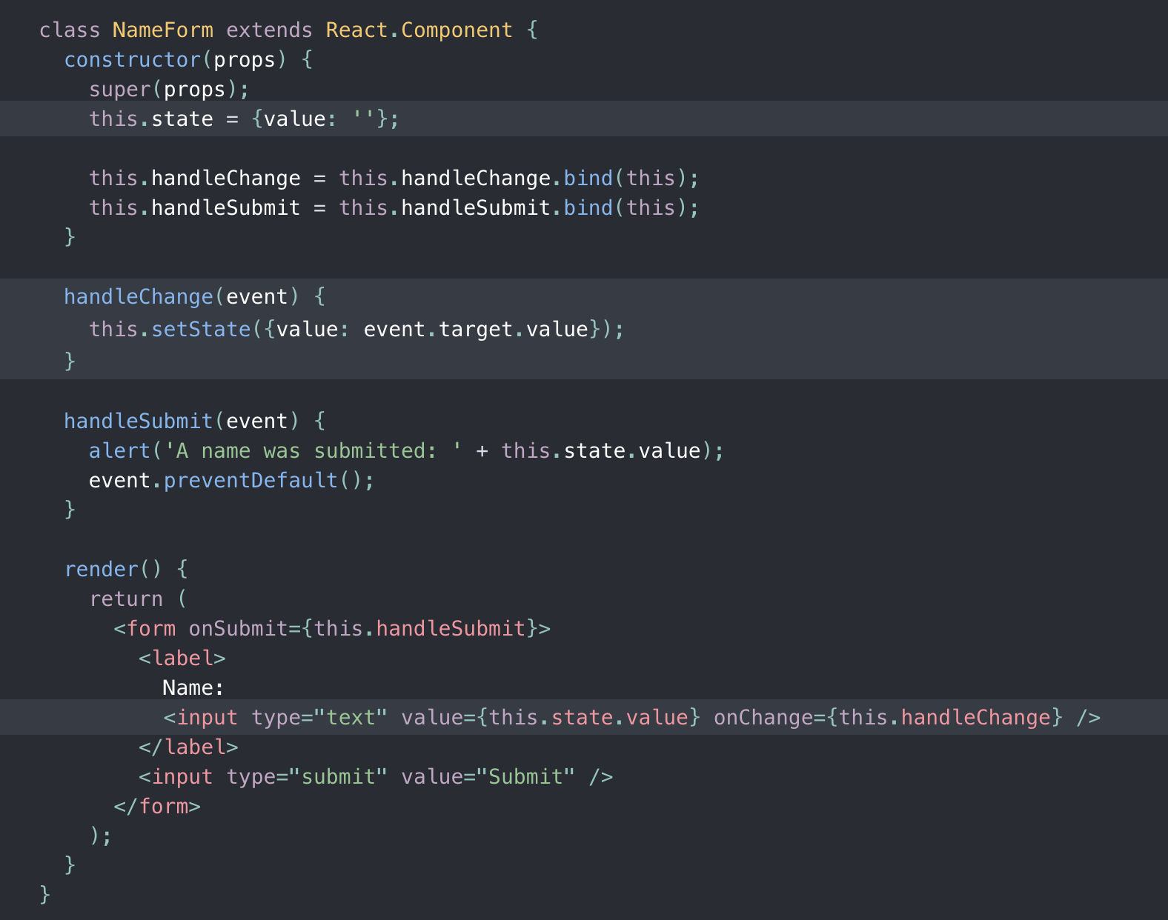
Using Controlled Form Elements
Prevent default HTML form submit
Provide Initial value (if desired)
Assign event handler
https://reactjs.org/docs/forms.html

Slide 23
More on setState
What if the state you need to update is in a different component than the component that is raising the event?
Functions are first-class citizens in JavaScript
Props can be functions!
Pass event handler as prop
If the component raising event is sibling of component that contains state, raise state up to common parent component level

Slide 24

Code Along Practice – Adding a Developer Dynamically
Elevate state to App.js. Elevate App.js to class component. Create handleNewDeveloper method to handle setState()
Demote DisplayBios.js to functional component and move its state to App.js
Create a new class component called AddDeveloper that contains a form for adding a developer
Create a method to handleChange of inputs.
Create method to handle the submit. It should call handleNewDeveloper method from props which is being passed down by App.js
Update the developer array
Clear the form
Add the AddDeveloper component to App.js. Pass event handler to it and pass developers to DisplayBios

Slide 25
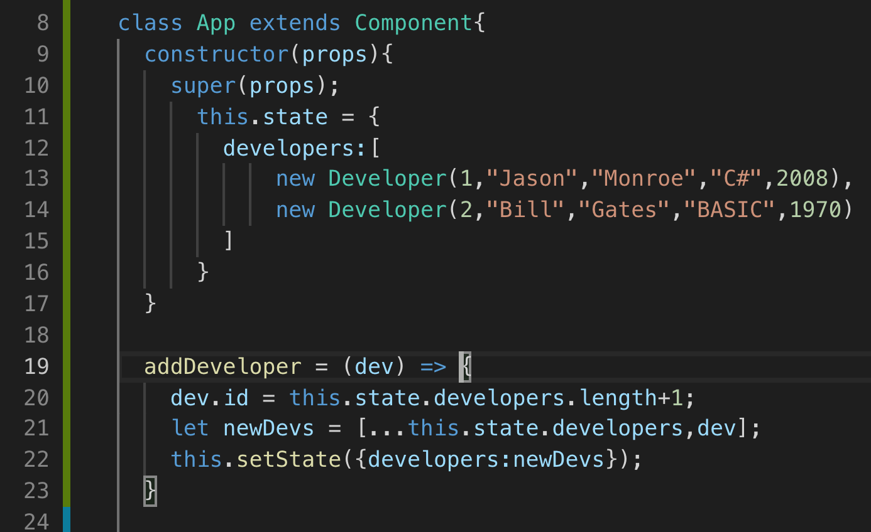
App.js

Slide 26
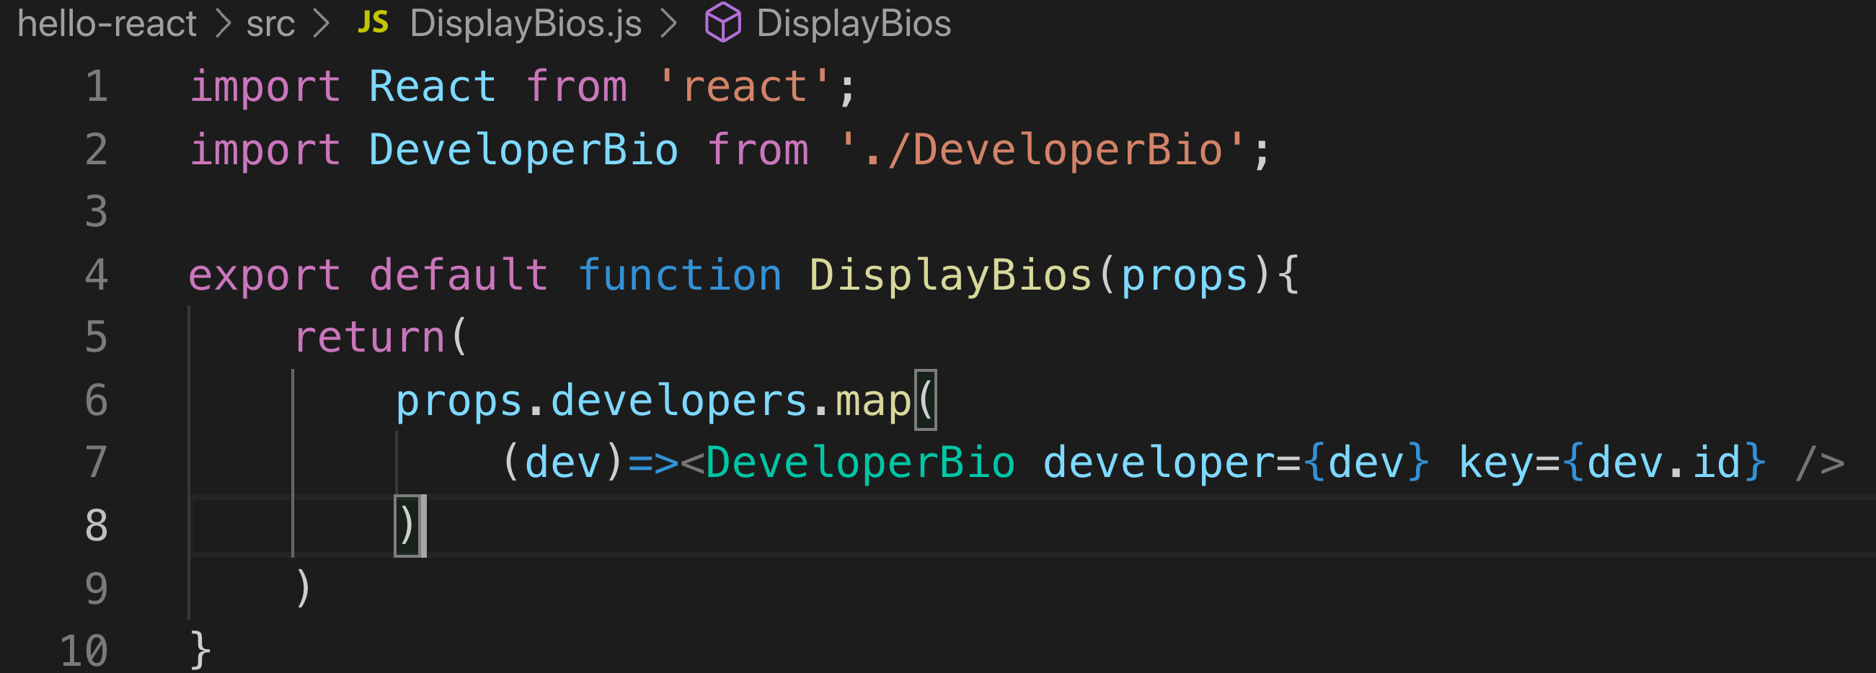
DisplayBios Converted to Functional Component

Slide 27
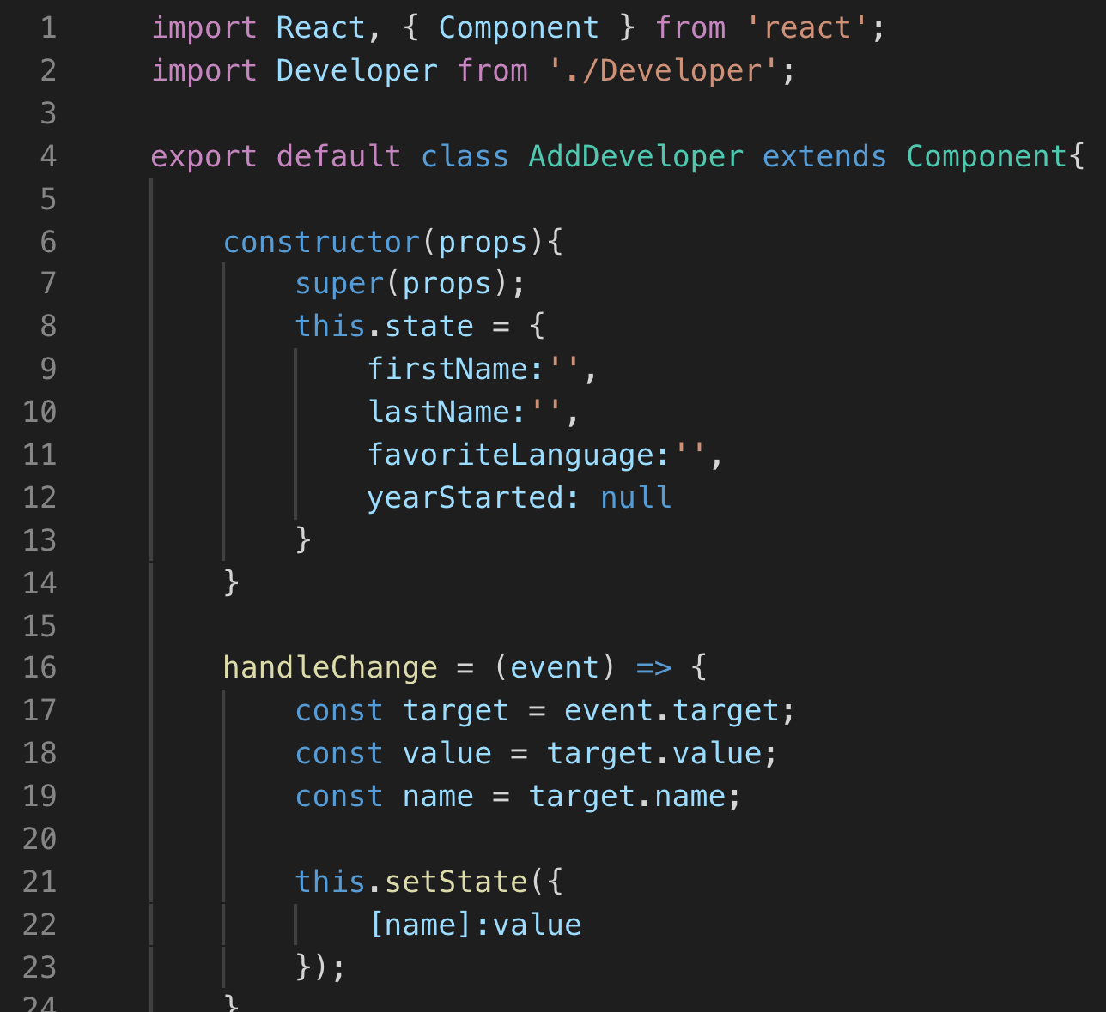
AddDeveloper Class Component
Initial empty form state
Handles change for every input

Slide 28
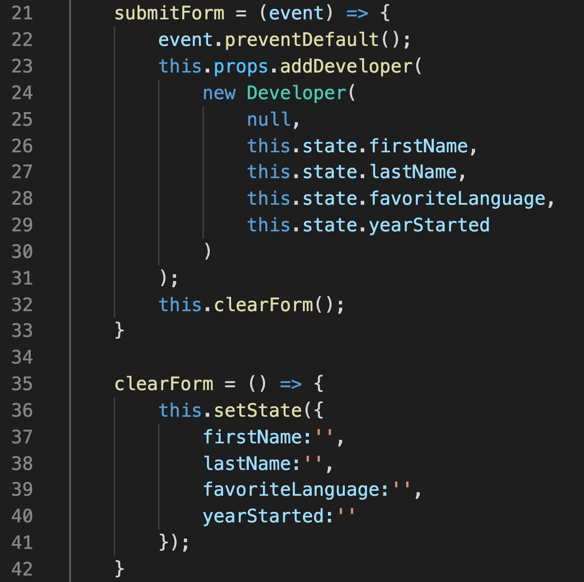
AddDeveloper Class Component (continued)
Call addDeveloper from props which is getting passed down from App.js

Slide 29
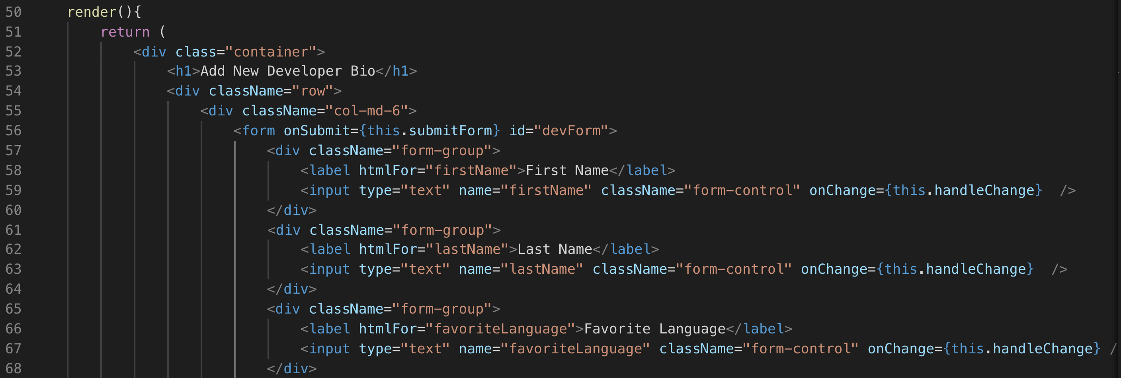
AddDeveloper Class Component (continued)
className and htmlFor are JSX representations of class and for

Slide 30
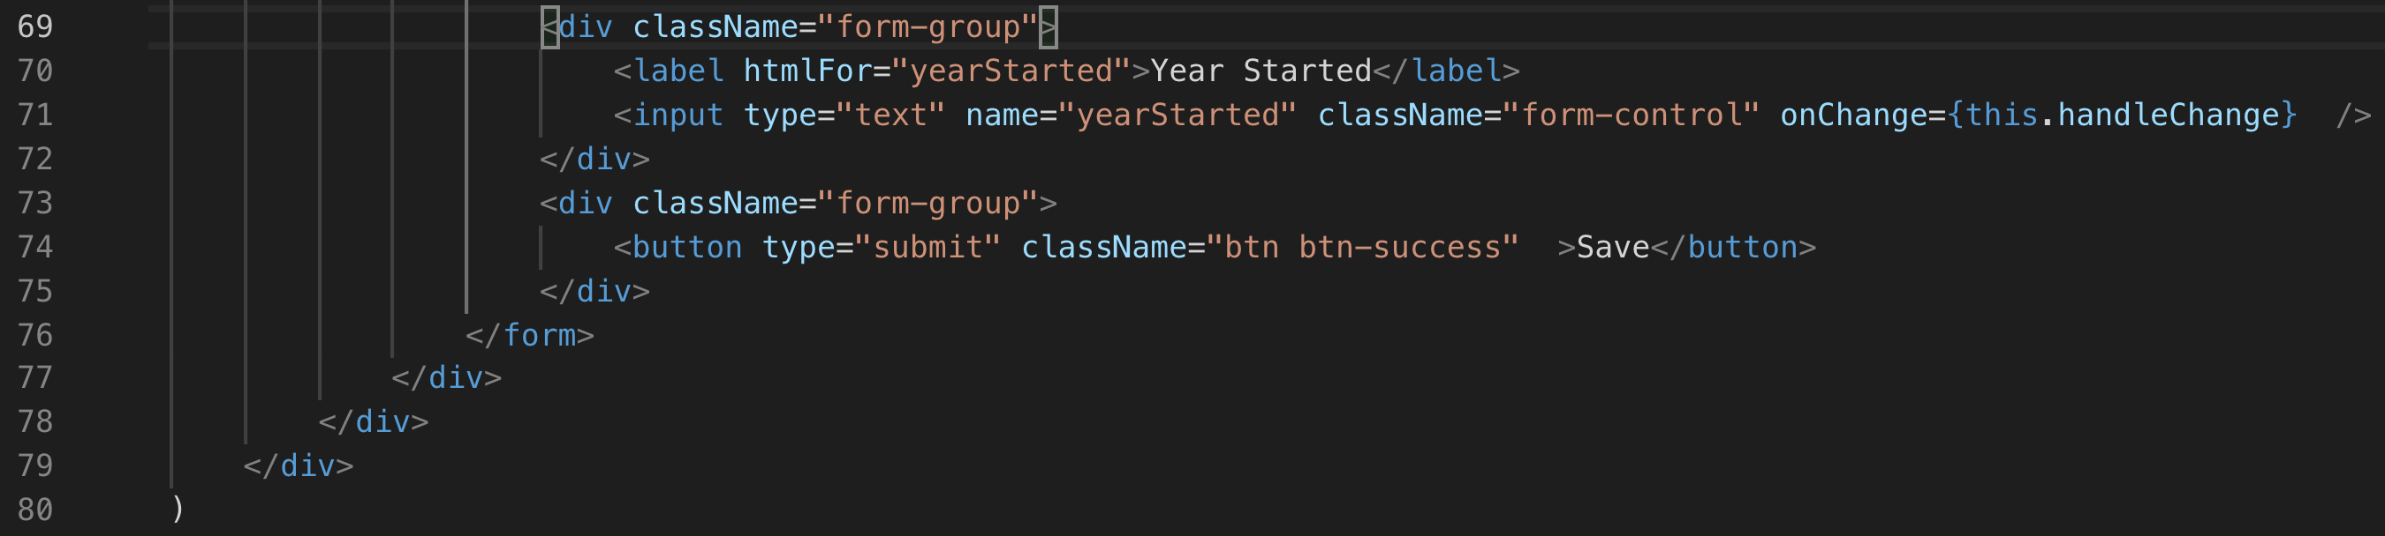
AddDeveloper Class Component (continued)

Slide 31
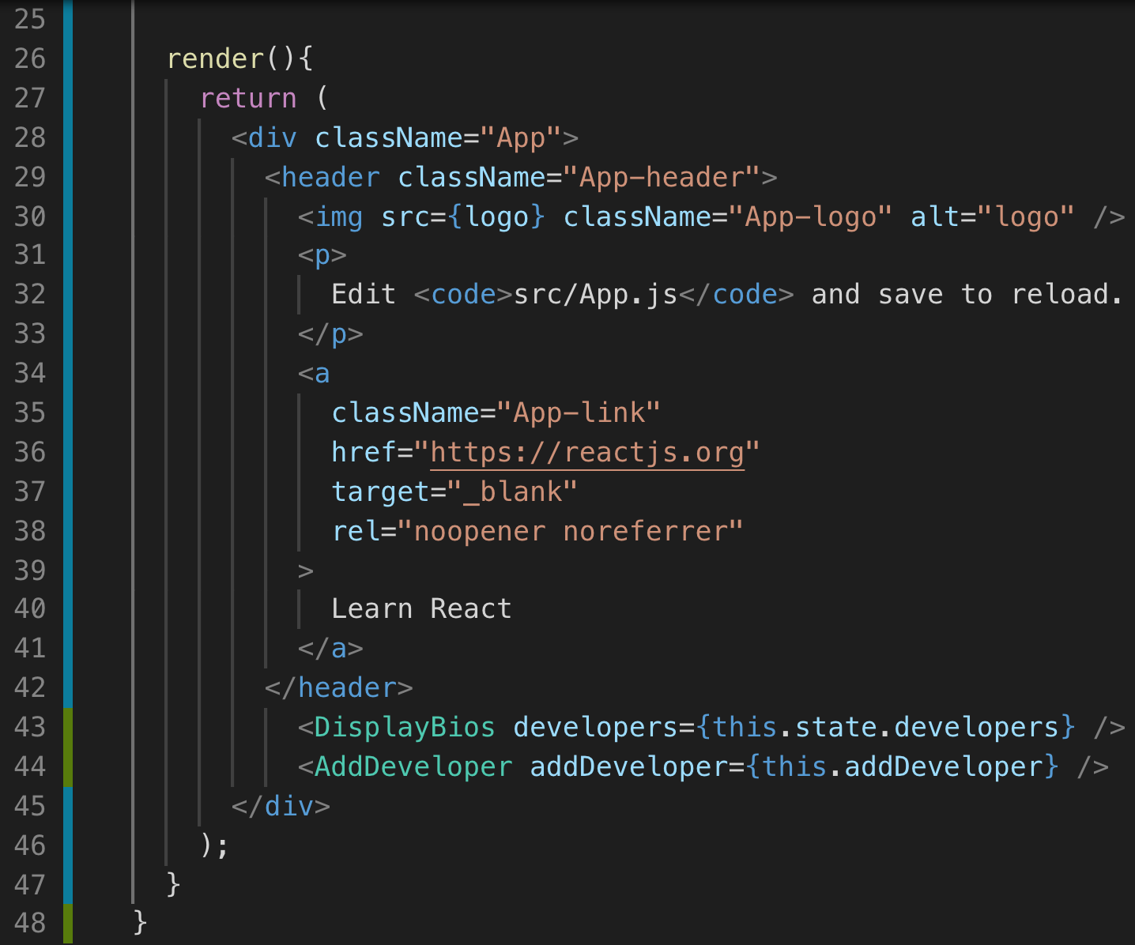
2. Add Component to App
Pass devs to DisplayBios
Pass addDeveloper as prop

Slide 32
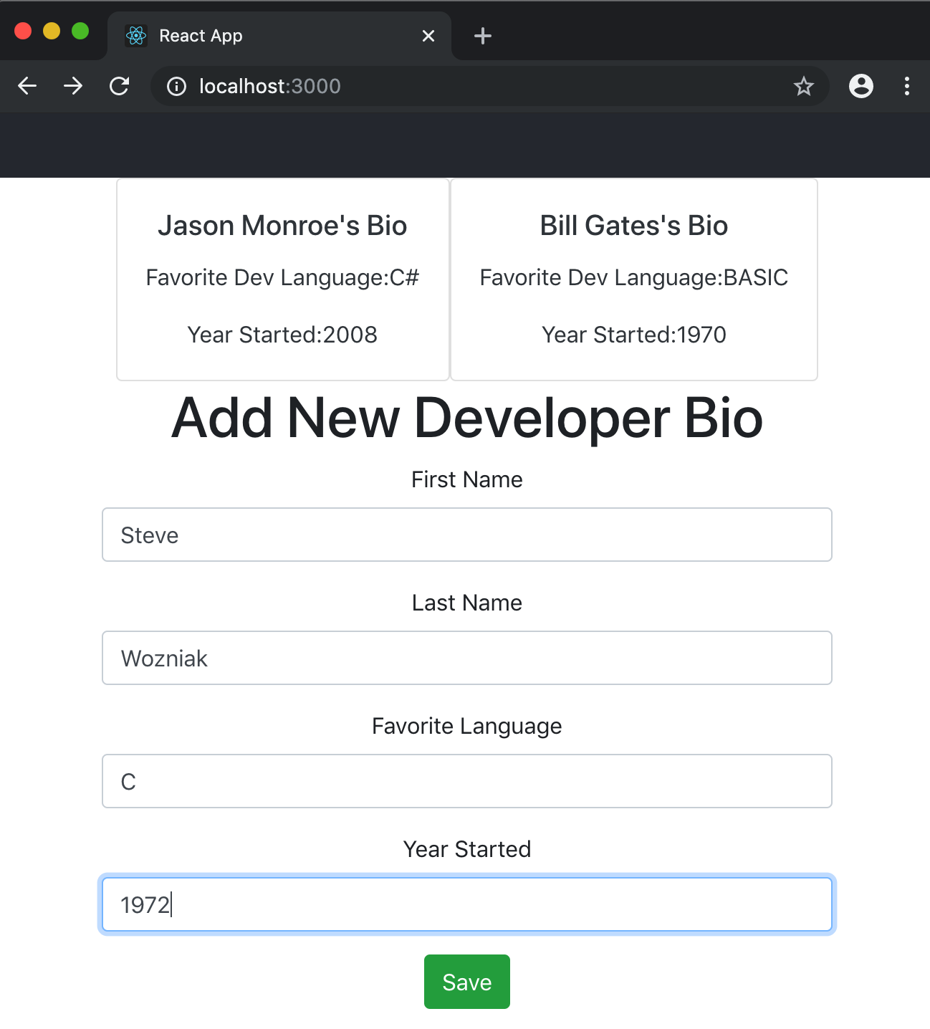
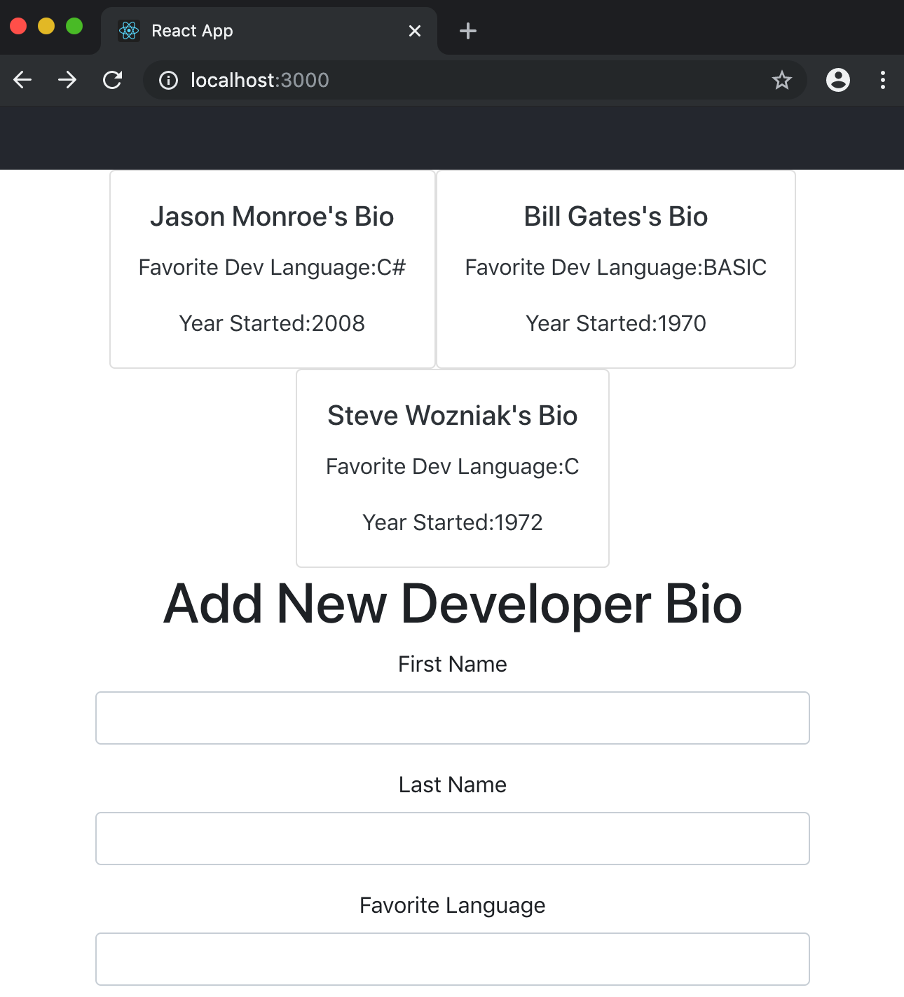
Finished product

Slide 33
On Your Own

Slide 34
On Your Own
Go to https://github.com/<<Our Organization>>/todos-react
Follow the instructions in the README.md file to complete the project.

Slide 35
Review
Event Handling
Updating State
Binding and ‘this’
Forms

Slide 36

Practice Check
Which of these are applicable in the context of React?
I React uses virtual DOM which represents the react elements, state and so on
II In React, state should not be mutated directly, but updated with setState method
III In React, props should be mutable.
IV React can be rendered on server side
I, II, III, and IV
I and III
I and II
I, II, and IV

Slide 37
Practice Check
2. Which of these are applicable in the context of React state?
I State is the single source of truth in react
II When setState is called it is always guaranteed that render method is called.
III Passing state as props follows top-down data flow.
IV setState() can be used in render() method to update state.
I, II, and III
I and III
I and II
I, II, III, and IV

Slide 38
Course Objective:
At the end this 120 min session, you will be able to
Handle DOM events with React components
Update the state of a component
Describe the rules of ‘this’ as applied to binding
Create a form and handle its change

Slide 39
What are the challenges to the way React events are handled?
What are the benefits?

Slide 40
Thank You

